Slide 1
Double fertilization in flowering plants
The process is given for your reference only
Key points you need to note is highlighted in red

Slide 2
Formation of female gametes
Key point to note:
Ovule is the carrier of female gamete (ovum), not the female gamete itself.

Slide 3
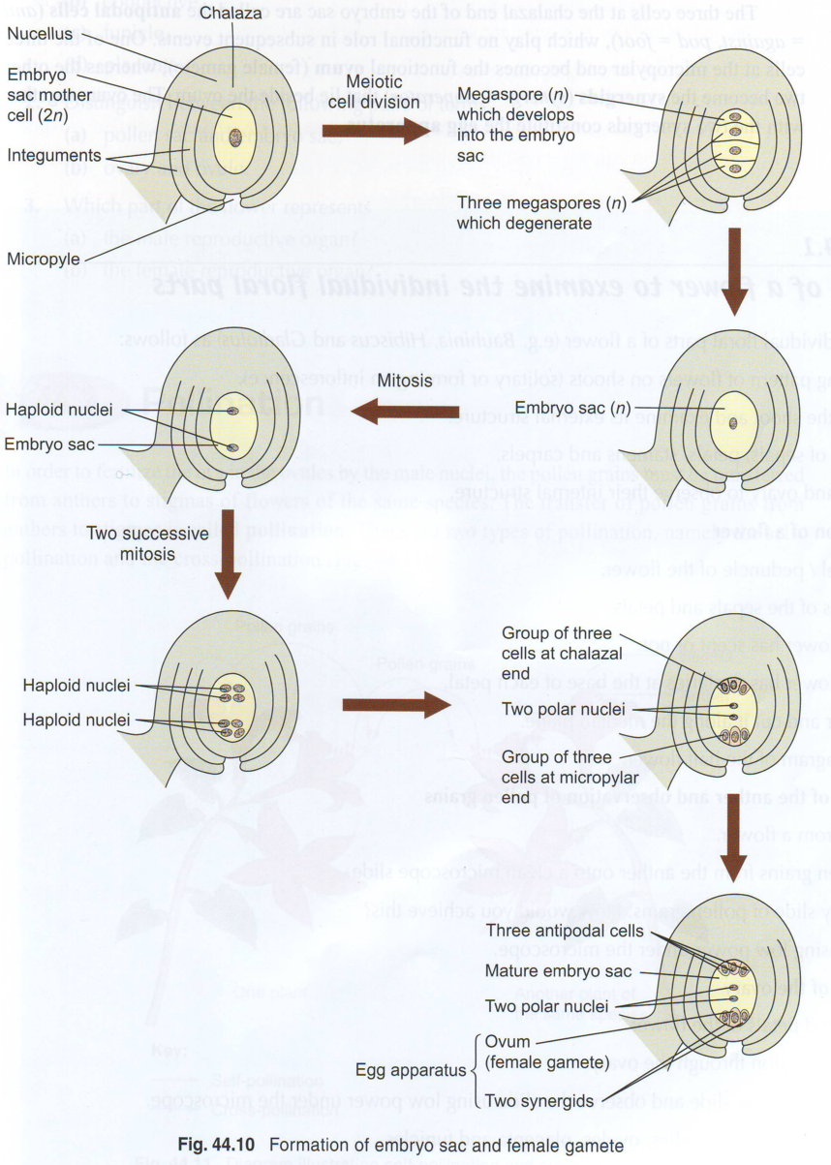
Reference only:
Meiotic cell division

Slide 4
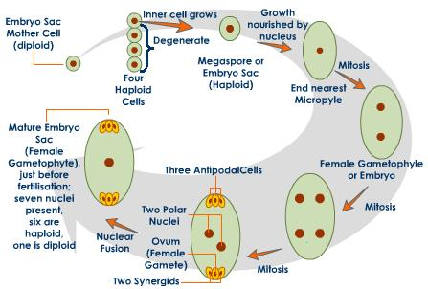
Reference
meiosis

Slide 5
Formation of pollen grains
Key point to note:
Pollen grain is the carrier of male gametes (the two male nuclei formed from the generative nucleus), not the male gamete itself.

Slide 6
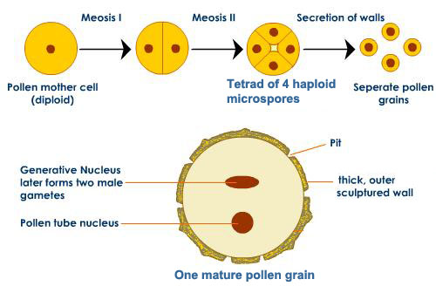

Slide 7
Double fertilization

Slide 8
